Slide 1

SQL for Database Interaction
By: Amirsina Eskandarifar
Amirsina.e@gmail.com

Slide 2
Database?!
Huge amount of Data -> We need something to organise collection of data
Organising -> Design and Modeling -> Users
The software that interacts with end users -> Database Management System (DBMS)
An example of data model: RDBMS Relational Database Management System -> a Database model based on rows, columns, and tables
SQL for Database Interaction by Amirsina Eskandarifar

Slide 3
SQL?!
Structural Query Language (SQL) -> The most common language to interact with database
Different Relational Database Management Systems (RDBMS) : Oracle, MySQL (Free software), Microsoft SQL Server, PostgreSQL, and …
All use same language: SQL (although they may vary in minor syntaxes sometimes)
SQL for Database Interaction by Amirsina Eskandarifar

Slide 4
SQL is a Declarative programming Language
Declarative Language
SQL
What to accomplish?
No control over the flow
Eliminate Side Effects
Simplify Parallel Programming
Example
Procedural Language
C++, Python, Java
How to accomplish?
Algorithm
User control
Harder for parallel programming
SQL for Database Interaction by Amirsina Eskandarifar

Slide 5
What is the process in RDBMS?
- Database design and model (how to organize the data?what tables to have?)
- Database creation (creating tables and specify constraints about tables)
- Database manipulation (analytics)
- Database maintenance and user interaction (administration jobs)
Saleries
Emp_no | Salery | From_date | To_date
10001 | 60117 | 1986-06-26 | 1987-06-26
10001 | 62102 | 1987-06-26 | 1988-06-25
10001 | 66074 | 1988-06-25 | 1989-06-25
10001 | 66596 | 1989-06-25 | 1990-06-25
10001 | 66961 | 1990-06-25 | 1991-06-25
Employees
Emp_no | Birth_date | First_name | Last_name | Gender | Hire_date
10001 | 1953-09-02 | Georgi | Facello | M | 1986-06-26
10002 | 1964-06-02 | Bezalel | Simmel | F | 1985-11-21
10003 | 1959-12-03 | Parto | Bamford | M | 1986-08-28
10004 | 1954-05-01 | Chirstian | Koblick | M | 1986-12-01
10005 | 1955-01-21 | Kyoichi | Maliniak | M | 1989-09-12
10006 | 1953-04-20 | Anneke | Preusig | F | 1989-06-02
10007 | 1957-05-23 | Tzvetan | Zielinski | F | 1989-02-10
Dept_manager
Emp_no | Dept_no | From_date | To_date
110022 | d001 | 1985-01-01 | 1991-10-01
110039 | d001 | 1991-10-01 | 9999-01-01
110085 | d002 | 1985-01-01 | 1989-12-17
110114 | d002 | 1989-12-17 | 9999-01-01
110183 | d003 | 1985-01-01 | 1992-03-21
SQL for Database Interaction by Amirsina Eskandarifar

Slide 6
What we can do with SQL (type of commands)
Data Definition Language (DDL):
Create database and database objects(e.g. table, functions)
Alter
Drop
Data Manipulation Language (DML):
Select: retrieve date
Insert: add date
Update: change existing data
Delete
Data Control Language (DCL):
Manage rights to users (Grant and Revoke)
Transaction Control Language (TCL):
Undo changes (Commit and Rollback)
Employees
Emp_no | Birth_date | First_name | Last_name | Gender | Hire_date
10001 | 1953-09-02 | Georgi | Facello | M | 1986-06-26
10002 | 1964-06-02 | Bezalel | Simmel | F | 1985-11-21
10003 | 1959-12-03 | Parto | Bamford | M | 1986-08-28
10004 | 1954-05-01 | Chirstian | Koblick | M | 1986-12-01
10005 | 1955-01-21 | Kyoichi | Maliniak | M | 1989-09-12
10006 | 1953-04-20 | Anneke | Preusig | F | 1989-06-02
10007 | 1957-05-23 | Tzvetan | Zielinski | F | 1989-02-10
SQL for Database Interaction by Amirsina Eskandarifar

Slide 7
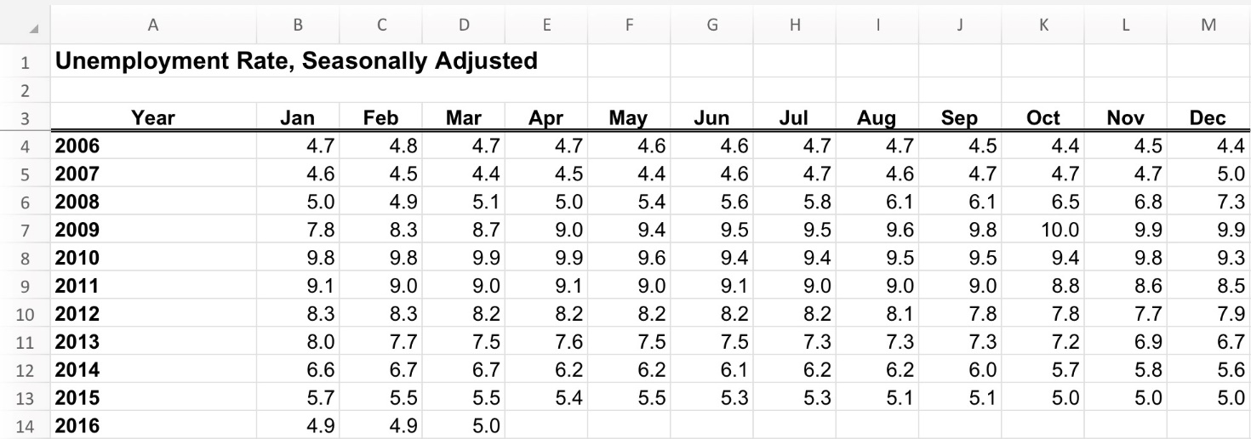
Question
What are the differences between Spreadsheet and Databases?
Emp_no | Birth_date | First_name | Last_name | Gender | Hire_date
10001 | 1953-09-02 | Georgi | Facello | M | 1986-06-26
10002 | 1964-06-02 | Bezalel | Simmel | F | 1985-11-21
10003 | 1959-12-03 | Parto | Bamford | M | 1986-08-28
10004 | 1954-05-01 | Chirstian | Koblick | M | 1986-12-01
10005 | 1955-01-21 | Kyoichi | Maliniak | M | 1989-09-12
10006 | 1953-04-20 | Anneke | Preusig | F | 1989-06-02
10007 | 1957-05-23 | Tzvetan | Zielinski | F | 1989-02-10
SQL for Database Interaction by Amirsina Eskandarifar

Slide 8
MySQL Workbench
User interface
Open employees.sql and then run it
If your database is in bold, it is a default database. Otherwise, by double clicking on its name it becomes the default.
SQL for Database Interaction by Amirsina Eskandarifar

Slide 9
SELECT: First Query!
Retrieving data is the most common command in SQL specially if you are a data scientist:
SELECT columns_1 , columns_2 , columns_3 FROM Table_1;
Select all: SELECT * FROM Table_1;
If the database of table you are selecting from is not the default database, you need to specify database name by:
SELECT columns_1 , columns_2 , columns_3 FROM Database_1.Table_1;
SQL for Database Interaction by Amirsina Eskandarifar

Slide 10
SELECT DISTINCT
To get distinct (different) rows (records)
SELECT DISTINCT columns_1 , columns_2 FROM Table_1;
SQL for Database Interaction by Amirsina Eskandarifar

Slide 11
WHERE: Adding Condition
You can filter rows by adding condition:
WHERE CONDITION_1 (AND/OR) CONDITION_2
Example:
SELECT last_name, first_name, gender FROM employees
WHERE gender = ‘M’ AND first_name = ‘Denis’ ;
SQL for Database Interaction by Amirsina Eskandarifar

Slide 12
WHERE: AND / OR
What do you expect from this query:
SELECT * FROM employees
WHERE last_name = ‘Denis’ AND gender = ‘M’ OR gender= ‘F’;
AND > OR
add bracket to control the priority!
SQL for Database Interaction by Amirsina Eskandarifar

Slide 13
WHERE: NOT and IN
NOT: obvious :D
IN: Instead of putting multiple OR conditions for equality, you can use IN. Example:
SELECT * FROM employees
WHERE first_name IN (‘Danis’ , ’Mark’ , ‘Nathan’);
SQL for Database Interaction by Amirsina Eskandarifar

Slide 14
WHERE: BETWEEN
Example:
SELECT * FROM employees
WHERE hire_date BETWEEN ‘1990-01-01’ AND ‘2000-01-01’;
SQL for Database Interaction by Amirsina Eskandarifar

Slide 15
WHERE: LIKE
Searching for pattern? -> Use LIKE!
Examples:
SELECT * FROM employees
WHERE first_name LIKE (‘Mar%’);
Return everything starts like “Mar”
SELECT * FROM employees
WHERE first_name LIKE (‘Mar_’);
Return all four character names starts with “Mar”
SQL for Database Interaction by Amirsina Eskandarifar

Slide 16
WHERE: IS NULL / IS NOT NULL
When we want to filter by missing values:
SELECT * FROM Table_1
WHERE columns_1 IS NULL / IS NOT NULL;
Find if there is any missing value in the employees table?
SQL for Database Interaction by Amirsina Eskandarifar

Slide 17
WHERE: other comparison operator
> more
< less
>= equal or more
<= equal or less
!= inequality
<> inequality
SQL for Database Interaction by Amirsina Eskandarifar

Slide 18
ORDER BY
To sort your retrieved data:
SELECT * FROM Table_1
WHERE Condition_1
ORDER BY column_1, column_2 ASC/DESC;
SQL for Database Interaction by Amirsina Eskandarifar

Slide 19
LIMIT
To get limited number of records:
SELECT * FROM Table_1
WHERE Condition_1
ORDER BY column_1 ASC/DESC
LIMIT number;
Or you can specify to numbers to return a window:
LIMIT number_1, number_2
It returns results between row number_1 and number_2
SQL for Database Interaction by Amirsina Eskandarifar

Slide 20
Aggregation
What does aggregation mean?
What operation we can apply on these group of numbers to get one value at the end? What if they were group of names instead?
100, 90, 95, 86, 65, 100, 12, 53, 93
SQL for Database Interaction by Amirsina Eskandarifar

Slide 21
Aggregation Functions
Max(), min(), avg(), count(), count(distinct ), sum()
Find max salary that the company is still paying?
SELECT max(salary) FROM salaries
Find number of rows for table employees?
SELECT count(*) FROM employees
SQL for Database Interaction by Amirsina Eskandarifar

Slide 22
Alias
In SQL we can define an alias for a column, this has a common use for column of aggregations:
SELECT max(salary) AS max_salary
FROM salaries
AS is optional, command below has the same result
SELECT max(salary) max_salary
FROM salaries
SQL for Database Interaction by Amirsina Eskandarifar

Slide 23
SQL for Database Interaction: Second Session

Slide 24
Last Session
Initial concept about SQL and RDBMS
SELECT -> SELECT DISTINCT
WHERE -> AND/OR , BETWEEN , IN , LIKE(%/_)
ORDER BY
LIMIT
Aggregation concept and GROUP BY
SQL for Database Interaction by Amirsina Eskandarifar

Slide 25
Example From Last Session
How much the company is monthly paying for employees’ salary at the moment?
Hint: salary table: WHERE + SUM() Answer: 5874846442
SELECT SUM(salary) as sum_salary
FROM salaries
WHERE to_date > '2018-01-01’;
Who is the oldest employee that was hired on the year 1995?
Hint: employee table: WHERE + BETWEEN + ORDER BY + LIMIT Answer: Moto or Rasiash?
SELECT * FROM employees
WHERE hire_date BETWEEN '1995-01-01' AND '1996-01-01’
ORDER BY birth_date ASC
LIMIT 1;
SQL for Database Interaction by Amirsina Eskandarifar

Slide 26
Example
Find out title of oldest female employee that her first name starts with ‘Nic’?

Slide 27
GROUP BY
Group by format:
SELECT Columns_1,
agg(columns_2)
FROM Table_1
WHERE Condition_1
GROUP BY Columns_1
Order by Columns_1
LIMIT 1
SQL for Database Interaction by Amirsina Eskandarifar

Slide 28
GROUP BY
You have a table like:
Table_1
Grouping by gender:
Extracting rows having identical values
What aggregation?
SELECT gender,
count(*),
sum(salary)
FROM Table_1
GROUP BY gender
SELECT ?
FROM Table_1
GROUP BY gender
SQL for Database Interaction by Amirsina Eskandarifar

Slide 29
GROUP BY multiple columns
If you want to retrieve their title, you need to group by title as well:
DON’T FORGET: after grouping you have to put an aggregation function for those retrieved columns that are not grouped.
SELECT title,
gender,
count(*),
sum(salary)
FROM Table_1
GROUP BY title,
gender
SQL for Database Interaction by Amirsina Eskandarifar

Slide 30
Example
Who has the highest income growth during their employment (report their emp_no)?
Hint: salary table: WHERE + GROUP BY + ORDER BY + MAX() + MIN() Answer: 43145
SQL for Database Interaction by Amirsina Eskandarifar

Slide 31
HAVING
For filtering grouped data use HAVING
SELECT Columns_1,
agg(columns_2)
FROM Table_1
WHERE Condition_1
GROUP BY Columns_1
HAVING Condition_2
SQL for Database Interaction by Amirsina Eskandarifar

Slide 32
WHERE vs HAVING
What is the difference between WHERE and HAVING?
WHERE: applying condition on selecting data among all rows in the table
HAVING: applying condition after grouping and aggregating the data
Tip: you cannot use aggregation function in WHERE
SQL for Database Interaction by Amirsina Eskandarifar

Slide 33

WHERE vs HAVING
Example: Considering following table (rows related to emp_no = 10001 is only shown):
Question: Find out employees with average salary more than 45000?
SELECT emp_no, avg(salary) FROM Salaries
WHERE avg(salary) > 45000
GROUP BY emp_no
emp_no | salary | Year
10001 | 40,000 | 2015-2016
10001 | 50,000 | 2016-2017
10001 | 90,000 | 2017-2018
B) SELECT emp_no, salary FROM Salaries
GROUP BY emp_no
HAVING avg(salary) > 45000
Error! Aggregate functions is not allowed in WHERE, because WHERE filter the table before aggregation
Error! It groups the table only based on emp_no, but salary is selected and NOT aggregated.
C) SELECT emp_no, avg(salary) FROM Salaries
WHERE salary > 45000
GROUP BY emp_no
D) SELECT emp_no, avg(salary) FROM Salaries
GROUP BY emp_no
HAVING avg(salary) > 55000
Incorrect return, it filters first row and then aggregate:
emp_no salary
10001 70,000
Correct! It first aggregate the table based on emp_no and then filter rows that calculated average is less than 55000: emp_no salary
10001 60,000
SQL for Database Interaction by Amirsina Eskandarifar

Slide 34
Primary Key
A column (or a set of columns) whose value exists and is unique for every record in a table is called a primary key
Employees
departments
Emp_no | Birth_date | First_name | Last_name | Gender | Hire_date
10001 | 1953-09-02 | Georgi | Facello | M | 1986-06-26
10002 | 1964-06-02 | Bezalel | Simmel | F | 1985-11-21
10003 | 1959-12-03 | Parto | Bamford | M | 1986-08-28
10004 | 1954-05-01 | Chirstian | Koblick | M | 1986-12-01
10005 | 1955-01-21 | Kyoichi | Maliniak | M | 1989-09-12
10006 | 1953-04-20 | Anneke | Preusig | F | 1989-06-02
10007 | 1957-05-23 | Tzvetan | Zielinski | F | 1989-02-10
dept_no | dept_name
d009 | Customer Service
d005 | Development
d002 | Finance
d003 | Human Resources
SQL for Database Interaction by Amirsina Eskandarifar

Slide 35
Foreign Key
It is column (or set of column) that connects and relates tables to each other.
departments
dept_no | dept_name
d009 | Customer Service
d005 | Development
d002 | Finance
d003 | Human Resources
employees
Emp_no | Birth_date | First_name | Last_name | Gender | Hire_date
10001 | 1953-09-02 | Georgi | Facello | M | 1986-06-26
10002 | 1964-06-02 | Bezalel | Simmel | F | 1985-11-21
10003 | 1959-12-03 | Parto | Bamford | M | 1986-08-28
10004 | 1954-05-01 | Chirstian | Koblick | M | 1986-12-01
10005 | 1955-01-21 | Kyoichi | Maliniak | M | 1989-09-12
10006 | 1953-04-20 | Anneke | Preusig | F | 1989-06-02
10007 | 1957-05-23 | Tzvetan | Zielinski | F | 1989-02-10
dept_manager
Emp_no | dept_no | From_date | To_date
110022 | d001 | 1985-01-01 | 1991-10-01
110039 | d001 | 1991-10-01 | 9999-01-01
110085 | d002 | 1985-01-01 | 1989-12-17
110114 | d002 | 1989-12-17 | 9999-01-01
110183 | d003 | 1985-01-01 | 1992-03-21
SQL for Database Interaction by Amirsina Eskandarifar

Slide 36
Questions?
Define a primary key for each table:
Saleries
dept_manager
Emp_no | Salery | From_date | To_date
10001 | 60117 | 1986-06-26 | 1987-06-26
10001 | 62102 | 1987-06-26 | 1988-06-25
10001 | 66074 | 1988-06-25 | 1989-06-25
10001 | 66596 | 1989-06-25 | 1990-06-25
10001 | 66961 | 1990-06-25 | 1991-06-25
Emp_no | dept_no | From_date | To_date
110022 | d001 | 1985-01-01 | 1991-10-01
110039 | d001 | 1991-10-01 | 9999-01-01
110085 | d002 | 1985-01-01 | 1989-12-17
110114 | d002 | 1989-12-17 | 9999-01-01
110183 | d003 | 1985-01-01 | 1992-03-21
SQL for Database Interaction by Amirsina Eskandarifar

Slide 37
Unique Key
Very similar to primary key, BUT:
They can be missing values (null value)
There might be no, one or multiple unique key columns in the table
Companies
Company_id | HQ_Phone | Industry | Address
1 | 647-812-1234 | Automotive | 12 Hillcrest ave, Toronto, ON
2 | 416-821-3475 | Technology | 82 Elm st, Toronto, ON
3 | 800-305-1231 | Food | 124 George Ave, Los Angles, CA
4 | 424-133-1232 | Technology | 56 Euclid Ave, Boston, MA
SQL for Database Interaction by Amirsina Eskandarifar

Slide 38
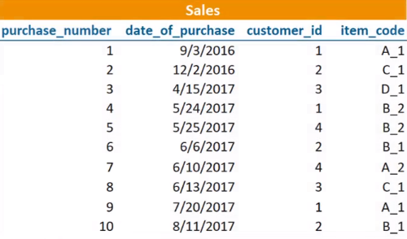
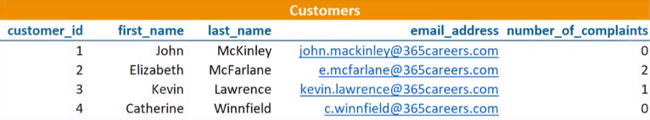
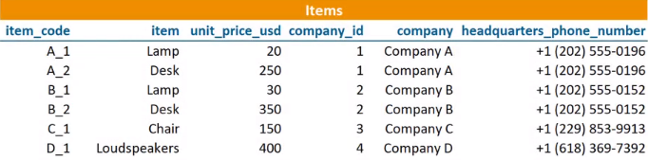
Relational Schemas
SQL for Database Interaction by Amirsina Eskandarifar

Slide 39
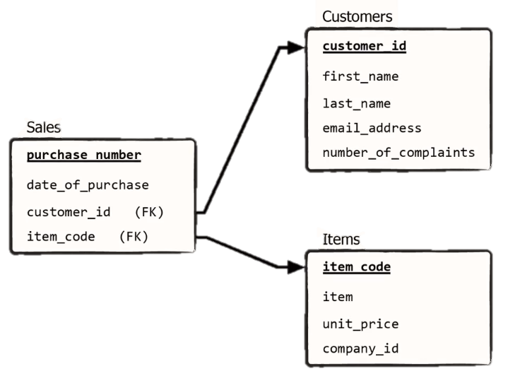
Relational Schemas
Each table is shown in a box with all column names
The underlined column is the primary key
Foreign key is mentioned in the bracket
It shows how tables are related to each others
The relation can be one to one, one to many, many to one and etc (not shown here to avoid complexity)
The database modeler design this chart to find out how to store and organize the data
SQL for Database Interaction by Amirsina Eskandarifar

Slide 40
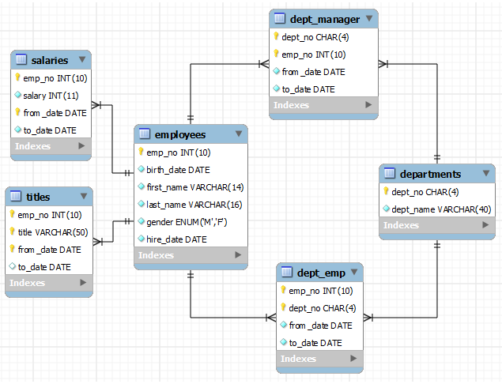
Relational Schemas
Employees database relational schemas:
SQL for Database Interaction by Amirsina Eskandarifar

Slide 41
JOIN
Join is used to combine two or more tables together:
dept_manager
departments
Emp_no | dept_no | From_date | To_date
110022 | d001 | 1985-01-01 | 1991-10-01
110039 | d001 | 1991-10-01 | 9999-01-01
110085 | d002 | 1985-01-01 | 1989-12-17
110114 | d002 | 1989-12-17 | 9999-01-01
110183 | d003 | 1985-01-01 | 1992-03-21
dept_no | dept_name
d009 | Customer Service
d005 | Development
d002 | Finance
d003 | Human Resources
Join Table
Emp_no | dept_no | From_date | To_date | departments.dept_no | departments. dept_name
110022 | d001 | 1985-01-01 | 1991-10-01 | d001 | Marketing
110039 | d001 | 1991-10-01 | 9999-01-01 | d001 | Marketing
110085 | d002 | 1985-01-01 | 1989-12-17 | d002 | Finance
110114 | d002 | 1989-12-17 | 9999-01-01 | d002 | Finance
110183 | d003 | 1985-01-01 | 1992-03-21 | d003 | Human Resources
SQL for Database Interaction by Amirsina Eskandarifar

Slide 42
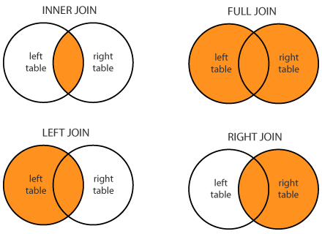
Different Kinds of JOINs
emp
dept
emp_no | name | dept_no | Salary | Fulltime
1 | David | 1 | 45k | Y
2 | John | 1 | 55k | Y
3 | Alex | 2 | 55k | Y
4 | Mariam | 3 | 65k | Y
5 | Jessie | 1 | 50k | Y
6 | Robert | null | 60k | N
dept_no | name
1 | HR
2 | Finance
3 | Analytics
4 | Product
5 | Business
6 | Development
Full Join
emp_no | name | dept_no | Salary | Fulltime | dept.dept_no | dept.name
1 | David | 1 | 45k | Y | 1 | HR
2 | John | 1 | 55k | Y | 1 | HR
3 | Alex | 2 | 55k | Y | 2 | Finance
4 | Mariam | 3 | 65k | Y | 3 | Analytics
5 | Jessie | 1 | 50k | Y | 1 | HR
6 | Robert | null | 60k | N | null | null
null | null | null | null | null | 4 | Product
null | null | null | null | null | 5 | Business
null | null | null | null | null | 6 | Development
Inner Join
Right Join
emp_no | name | dept_no | Salary | Fulltime | dept.dept_no | dept.name
1 | David | 1 | 45k | Y | 1 | HR
2 | John | 1 | 55k | Y | 1 | HR
3 | Alex | 2 | 55k | Y | 2 | Finance
4 | Mariam | 3 | 65k | Y | 3 | Analytics
5 | Jessie | 1 | 50k | Y | 1 | HR
emp_no | name | dept_no | Salary | Fulltime | dept.dept_no | dept.name
1 | David | 1 | 45k | Y | 1 | HR
2 | John | 1 | 55k | Y | 1 | HR
3 | Alex | 2 | 55k | Y | 2 | Finance
4 | Mariam | 3 | 65k | Y | 3 | Analytics
5 | Jessie | 1 | 50k | Y | 1 | HR
null | null | null | null | null | 4 | Product
null | null | null | null | null | 5 | Business
null | null | null | null | null | 6 | Development
Left Join
emp_no | name | dept_no | Salary | Fulltime | dept.dept_no | dept.name
1 | David | 1 | 45k | Y | 1 | HR
2 | John | 1 | 55k | Y | 1 | HR
3 | Alex | 2 | 55k | Y | 2 | Finance
4 | Mariam | 3 | 65k | Y | 3 | Analytics
5 | Jessie | 1 | 50k | Y | 1 | HR
6 | Robert | null | 60k | N | null | null
SQL for Database Interaction by Amirsina Eskandarifar

Slide 43
How to JOIN in SQL
To join two tables, you need to:
1- Define the condition and specify the relation between two tables
2- Specify kinds of JOIN
SELECT table_1.columns_1 , table_1.columns_2 , table_2.columns_2
FROM table_1 INNER JOIN table_2
ON table_1.columns_1 = table_2.columns_1 ;
SQL for Database Interaction by Amirsina Eskandarifar

Slide 44
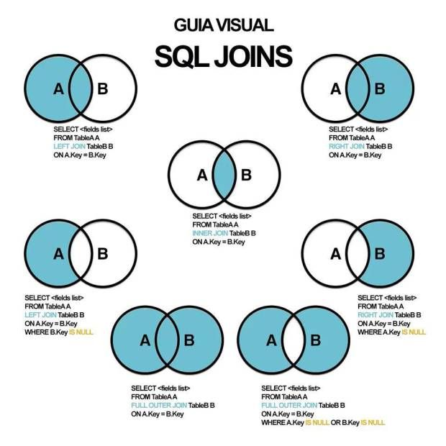
SQL for Database Interaction by Amirsina Eskandarifar

Slide 45
Notes about JOINs
What do you expect from the query below?
SELECT *
FROM employees e LEFT JOIN salaries s
ON e.emp_no = s.emp_no;
If the destination table has duplicate values to join to original table, all those values will be shown in the result set (no matter what kinds of join it is).
SQL for Database Interaction by Amirsina Eskandarifar

Slide 46
Multiple JOINs
You can join multiple tables together fairly easy:
SELECT *
FROM employees e
JOIN salaries s
ON e.emp_no = s.emp_no
JOIN dept_emp d
ON e.emp_no = d.emp_no ;
SQL for Database Interaction by Amirsina Eskandarifar

Slide 47
Practice!
Compare average age and average salary and number of employees among female and male in the company? (JOIN)
SQL for Database Interaction by Amirsina Eskandarifar

Slide 48
Let’s review the process in SELECT statement
Find the table or tables (FROM & JOIN)
Filter the table (WHERE)
Group the table by columns specified (GROUP BY)
Calculate columns (aggregation or any other functions)
Filter grouped rows (HAVING)
Sort (ORDER BY)
LIMIT
SQL for Database Interaction by Amirsina Eskandarifar

Slide 49
SQL for Database Interaction: Third Session

Slide 50
So far
Select column_1,
agg(column_2) as name_1
FROM Table_1 t1 INNER JOIN Table_2 t2
ON t1.column_key = t2.column_key
WHERE condition_1
GROUP BY column_1
HAVING condition_2
ORDER BY name_1 DESC
LIMIT 10
SQL for Database Interaction by Amirsina Eskandarifar

Slide 51
Example From Last Session
1. Which manager is getting paid the least currently?
2. Find out average salary of each position or title in the company (based on current salaries)?
SQL for Database Interaction by Amirsina Eskandarifar

Slide 52
Solution
1.
SELECT *
FROM employees e INNER JOIN salaries s
ON e.emp_no = s.emp_no
INNER JOIN dept_manager d_m
ON e.emp_no = d_m.emp_no
WHERE s.to_date > '2018-01-01'
AND d_m.to_date > '2018-01-01'
ORDER BY s.salary ASC;
2.
SELECT title,
AVG(salary) avg_salary,
COUNT(distinct s.emp_no) cnt_employees
FROM salaries s
INNER JOIN titles t
ON t.emp_no = s.emp_no
WHERE s.to_date > '2018-01-01'
AND t.to_date > '2018-01-01'
GROUP BY t.title;
SQL for Database Interaction by Amirsina Eskandarifar

Slide 53
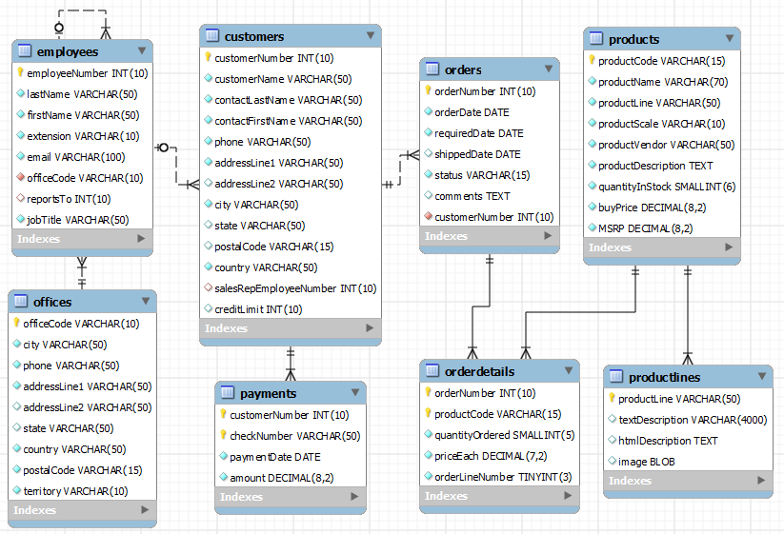
Let’s Try New Database
Download new database from portal: mysqlsampledatabase.sql
Run the code in MySQL Workbench
You can create relational schema or ER diagram with Workbench too:
SQL for Database Interaction by Amirsina Eskandarifar

Slide 54
Example
The dealership sales team wants to know which products are the most popular products in their store. Help them with a list of their product and their number of purchase.
Find out which product line is the most popular?
SQL for Database Interaction by Amirsina Eskandarifar

Slide 55
Solution
SELECT p.productCode,
p.productName,
sum(quantityOrdered) num_of_purchase
FROM products p INNER JOIN orderdetails od
ON p.productCode = od.productCode
GROUP BY p.productCode
ORDER BY num_of_purchase DESC
LIMIT 10;
SQL for Database Interaction by Amirsina Eskandarifar

Slide 56
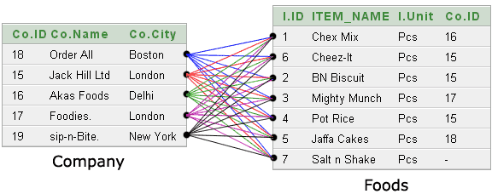
CROSS JOIN
It works like cartesian multiplication:
Each row from the first table would be combined with all rows from the second table:
No need to specify condition (ON)
No need to specify any column for doing the JOIN
Quite useless kind of JOIN!
SELECT * FROM dept_emp CROSS JOIN departments
SQL for Database Interaction by Amirsina Eskandarifar

Slide 57
UNION & UNION ALL
It combines two or more result sets of queries into a single result set (by default it is UNION DISTINCT):
SELECT column_1, columns_2 FROM table_1
UNION [DISTINCT | ALL]
SELECT column_1, columns_2 FROM table_2
You must follow these rules for using UNION:
1- The number and the orders of columns that appear in all SELECT statement must be the same.
2- The data types of columns must be the same.
SQL for Database Interaction by Amirsina Eskandarifar

Slide 58
Example
The car dealership wants to run a very targeted marketing campaign for its customers.
They want to target customers that has purchased more than three times OR purchased more than $100,000
Provide an analysis and report of customer names, address and phone numbers that helps the marketing team to target these customers:
SQL for Database Interaction by Amirsina Eskandarifar

Slide 59
Solution
SELECT c.customerNumber,
customerName,
phone,
postalCode,
addressLine1,
addressLine2,
COUNT(distinct orderNumber) num_or_amt_of_purchase
FROM customers c INNER JOIN orders o
ON c.customerNumber = o.customerNumber
GROUP BY customerNumber,
customerName,
phone,
postalCode,
addressLine1,
addressLine2
HAVING num_or_amt_of_purchase > 5
UNION ALL
SELECT c.customerNumber,
customerName,
phone,
postalCode,
addressLine1,
addressLine2,
SUM(amount) num_or_amt_of_purchase
FROM customers c INNER JOIN payments p
ON c.customerNumber = p.customerNumber
GROUP BY customerNumber,
customerName,
phone,
postalCode,
addressLine1,
addressLine2
HAVING num_or_amt_of_purchase > 150000;
SQL for Database Interaction by Amirsina Eskandarifar

Slide 60
SQL for Database Interaction: Fourth Session

Slide 61
Sub Queries
You can have a query inside another query!
SELECT column_1, column_2
FROM Table_1 WHERE column_2 IN ( SELECT column_2 FROM Table_2 WHERE condition_1);
SQL for Database Interaction by Amirsina Eskandarifar

Slide 62
Sub Queries with IN
Having sub queries using IN:
Example: Find out salary of people that are hired after 2000-01-01?
SELECT emp_no, salary
FROM salaries WHERE emp_no IN (SELECT emp_no FROM employees WHERE hire_date > '2000-01-01’);
What if we write this with JOIN instead?
SQL for Database Interaction by Amirsina Eskandarifar

Slide 63
Sub Queries with EXISTS
You can use sub queries using EXISTS:
Same example:
SELECT emp_no, salary
FROM salaries WHERE EXISTS (
SELECT emp_no FROM employees WHERE hire_date > '2000-01-01’ AND employees.emp_no = salaries.emp_no
);
SQL for Database Interaction by Amirsina Eskandarifar

Slide 64
IN vs EXISTS
EXISTS tests row values for existence BUT IN searches among values
EXISTS is quicker in retrieving large amount of data BUT IN is faster with smaller data
Use whichever is easier for you to understand
SQL for Database Interaction by Amirsina Eskandarifar

Slide 65
Practice
Do you remember customers from marketing campaign? (slide 57)
Now find out list of products that those customers have ordered with their number of orders.
SQL for Database Interaction by Amirsina Eskandarifar

Slide 66
Functions
Aggregate functions: MIN(), MAX(), SUM(), AVG(), COUNT(), COUNT(DISTINCT )
ROUND(), ABS()
IFNULL()
COALESCE()
http://www.mysqltutorial.org/mysql-functions.aspx
SQL for Database Interaction by Amirsina Eskandarifar

Slide 67
Practice
Look at orders table. Retrieve orders table with these additional columns:
1- a column named ‘comment_or_not’ indicating if there is a comment on the order or not. If yes, show the comment, if not indicate ‘no comment’
2- a column named ‘days_to_ship’ indicating time between orders date and shipped date (time in days).
SQL for Database Interaction by Amirsina Eskandarifar

Slide 68
CASE
If you want to change a column value you can use case:
SELECT
emp_no,
CASE
WHEN condition_1 THEN value_1
WHEN condition_2 THEN value_2
ELSE value_3
END AS ALIES,
Last_name
FROM Table_1
Find out number of female employees joined after 1995-01-01 and before this date
SQL for Database Interaction by Amirsina Eskandarifar

Slide 69
Practice
By having a newly created column named ‘days_to_ship’, create another column named ‘shipping_class’ indicating:
If ‘days_to_ship’ <= 3 days => ‘Express shipping’
If ‘days_to_ship’ > 3 days & ‘days_to_ship’ <= 15 days => ‘Regular shipping’
If ‘days_to_ship’ > 15 days => ‘Delayed shipping’
Others => ‘Unknown’
SQL for Database Interaction by Amirsina Eskandarifar

Slide 70
INSERT
For inserting new value:
INSERT INTO table_name (columns_1, columns_2, …)
VALUES (value_1, value_2, …);
Orders matter her. Be careful!
You can use select statement to insert multiple columns:
INSERT INTO table_name VALUES (
SELECT columns_1, columns_2, … FROM table_name_2);
SQL for Database Interaction by Amirsina Eskandarifar

Slide 71
UPDATE
Updating existing record (row):
UPDATE table_name
SET columns_1 = value_1, column_2 = value_2, …
WHERE condition_1;
WHERE clause is crucial! (you need to specify which row your particularly want to update)
SQL for Database Interaction by Amirsina Eskandarifar

Slide 72
DELETE
To delete single or multiple rows:
DELETE table_name
WHERE condition_1;
SQL for Database Interaction by Amirsina Eskandarifar

Slide 73
SQL for Database Interaction: Fifth Session

Slide 74
Constraints for Tables (DDL)
NOT NULL Constraint − Ensures that a column cannot have NULL value.
DEFAULT Constraint − Provides a default value for a column when none is specified.
UNIQUE Constraint − Ensures that all values in a column are different.
PRIMARY Key − Uniquely identifies each row/record in a database table.
FOREIGN Key − Uniquely identifies a row/record in any of the given database table.
CHECK Constraint − The CHECK constraint ensures that all the values in a column satisfies certain conditions.
INDEX − Used to create and retrieve data from the database very quickly.
SQL for Database Interaction by Amirsina Eskandarifar

Slide 75
Views
View is a virtual useful table that is run previously and is accessible to users to avoid writing and running same piece of code multiple times:
CREATE VIEW view_name AS
SELECT column_1, column_2 FROM table_name;
SQL for Database Interaction by Amirsina Eskandarifar

Slide 76
Routines
Routines are saved, usual, fixed action (or series of actions) and need to be run periodically.
Routines can be either procedure or function:
Example:
CREATE PROCEDURE emo_avg_salary_out (IN p_emp_no INTEGER, OUT p_avg_salary DECIMAL(10,2))
BEGIN
SELECT AVG(salary) INTO p_avg_salary
FROM salaries
WHERE emp_no = p_emp_no;
END
SQL for Database Interaction by Amirsina Eskandarifar

Slide 77
Extra: NoSQL (NotOnlySQL)
Traditional RDBMS limitations:
Not optimised to scale out
Not able to handle unstructured or varied structured data
Costly
But NoSQL is suitable for high velocity data ingestion and is highly distributed.
The most common NoSQL system is MongoDB
https://www.youtube.com/watch?v=2yQ9TGFpDuM
SQL for Database Interaction by Amirsina Eskandarifar

Slide 78
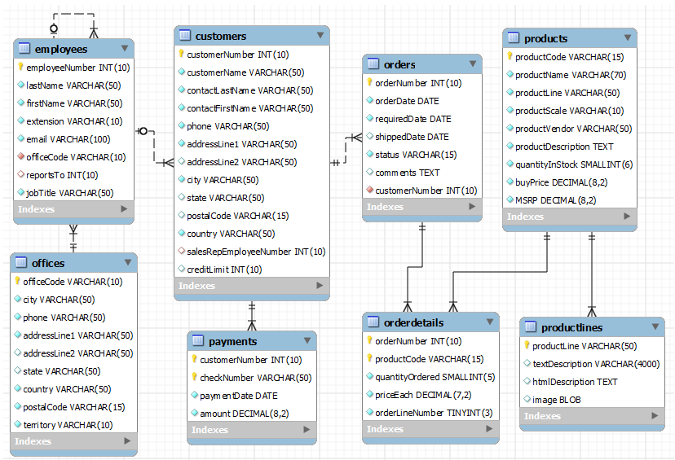
Next database: Retail DB
SQL for Database Interaction by Amirsina Eskandarifar

Slide 79
Thanks! Please provide me your feedback to improve this course

